Slide 1
Finding Shortest Path in Graph

Slide 2
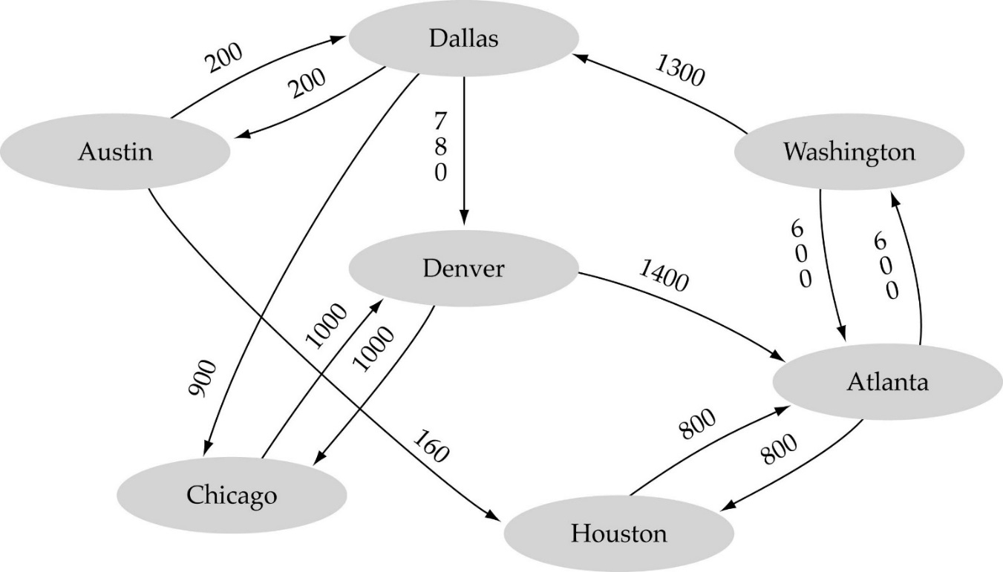
Single-source shortest-path problem
There are multiple paths from a source vertex to a destination vertex
Shortest path: the path whose total weight (i.e., sum of edge weights) is minimum.
Find shortest path from Austin to Washington

Slide 3
Single-source shortest-path problem
Austin → Houston → Atlanta → Washington :
  1560 miles
Austin → Dallas → Denver → Atlanta → Washington :
  2980 miles

Slide 4

Single-Source Shortest Path Problem
Single-Source Shortest Path Problem - The problem of finding shortest paths from a source vertex v to all other vertices in the graph.

Slide 5
Dijkstra's algorithm
Dijkstra's algorithm - is a solution to the single-source shortest path problem in graph theory.
Works on both directed and undirected graphs. However, all edges must have nonnegative weights.
Approach: Greedy
Input: Weighted graph G={V,E} and source vertex v∈V, such that all edge weights are nonnegative
Output: Lengths of shortest paths (or the shortest paths themselves) from a given source vertex v∈V to all other vertices

Slide 6
Dijkstra's algorithm - Pseudocode
dist[s] ← 0 (distance to source vertex is zero)
path[s] ←s (path of source is itself)
for all v ∈ V–{s}
do dist[v] ←∞ (set all other distances to infinity)
path[v] ← NULL (path of all other nodes is undefined initially)
S←∅ (S, the set of visited vertices is initially empty)
Q←V (Q, the queue initially contains all vertices)
while Q ≠∅ (while the queue is not empty)
do u ← mindistance(Q,dist) (select the element of Q with the min. distance)
S←S∪{u} (add u to list of visited vertices)
for all v ∈ neighbors[u]
do if dist[v] > dist[u] + w(u, v) (if new shortest path found)
then d[v] ←d[u] + w(u, v) (set new value of shortest path)
path[v] ←u (traceback code)
return dist
// return path

Slide 7
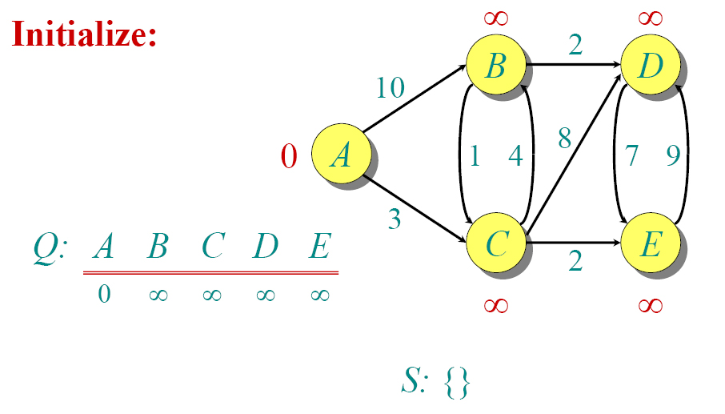
Dijkstra Animated Example

Slide 8

Dijkstra Animated Example

Slide 9

Dijkstra Animated Example

Slide 10

Dijkstra Animated Example

Slide 11

Dijkstra Animated Example

Slide 12

Dijkstra Animated Example

Slide 13

Dijkstra Animated Example

Slide 14

Dijkstra Animated Example

Slide 15

Dijkstra Animated Example

Slide 16

Dijkstra Animated Example

Slide 17
Dijkstra's Algorithm - Why use it?
As mentioned, Dijkstra’s algorithm calculates the shortest path to every vertex.
Anytime we want to know the optimal path to some other vertex from a determined origin, we can use Dijkstra’s algorithm.

Slide 18


Applications of Dijkstra's Algorithm
Traffic Information Systems are most prominent use
Mapping (Google Maps, Map Quest)
Routing Systems

Slide 19
Implementations and Running Times
The simplest implementation is to store vertices in an array or linked list. This will produce a running time of
O(|V|^2 + |E|)
For sparse graphs, or graphs with very few edges and many nodes, it can be implemented more efficiently storing the graph in an adjacency list using a binary heap or priority queue. This will produce a running time of
O((|E|+|V|) log |V|)

